Slide 1
Paging
Paging is a memory management scheme that eliminates the need for contiguous allocation of physical memory.
The process of retrieving processes in the form of pages from the secondary storage into the main memory is known as paging.
The basic purpose of paging is to separate each procedure into pages.
Additionally, frames will be used to split the main memory.
This scheme permits the physical address space of a process to be non – contiguous.
Let us look some important terminologies:
Logical Address or Virtual Address (represented in bits): An address generated by the CPU
Logical Address Space or Virtual Address Space( represented in words or bytes): The set of all logical addresses generated by a program
Physical Address (represented in bits): An address actually available on memory unit
Physical Address Space (represented in words or bytes): The set of all physical addresses corresponding to the logical addresses

Slide 2
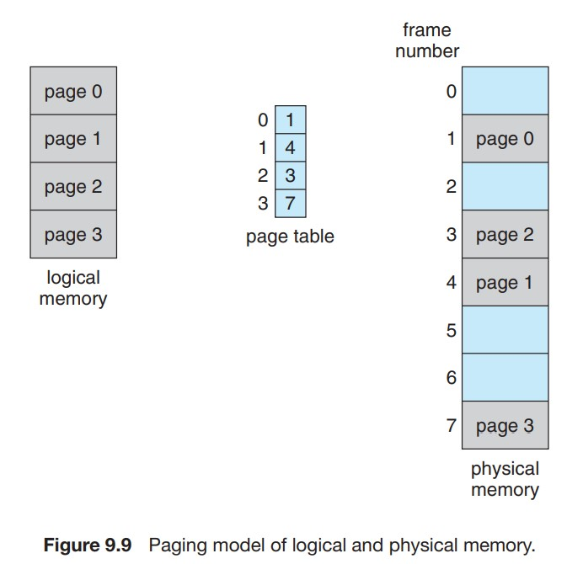

Slide 3
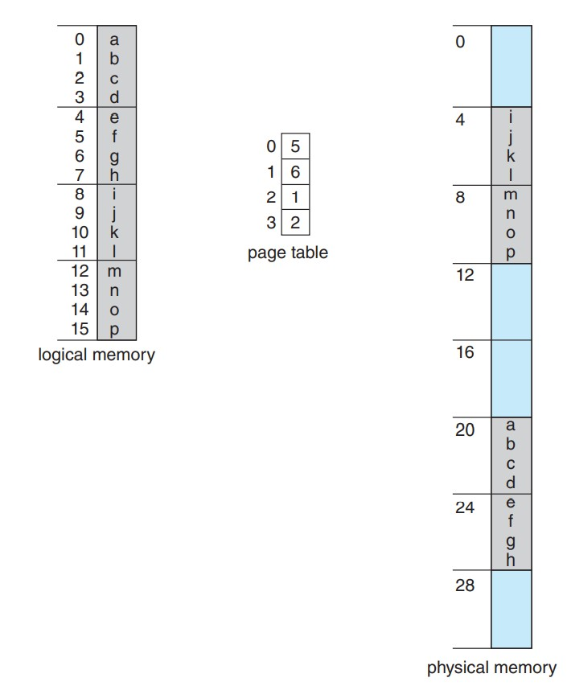
Fig. Paging example a 32 byte memory with 4-byte pages

Slide 4
Example:
If Logical Address = 31 bit, then Logical Address Space = 2³¹ words = 2 G words (1 G = 2³⁰)
If Logical Address Space = 128 M words = 2⁷ * 2²⁰ words, then Logical Address = log₂ 2²⁷ = 27 bits
If Physical Address = 22 bit, then Physical Address Space = 2²² words = 4 M words (1 M = 2²⁰)
If Physical Address Space = 16 M words = 2⁴ * 2²⁰ words, then Physical Address = log₂ 2²⁴ = 24 bits
The mapping from virtual to physical address is done by the memory management unit (MMU) which is a hardware device and this mapping is known as paging technique.

Slide 5
The Physical Address Space is conceptually divided into a number of fixed-size blocks, called frames.
The Logical address Space is also splitted into fixed-size blocks, called pages.
Page Size = Frame Size
Let us consider an example:
Physical Address = 12 bits, then Physical Address Space = 4 K words
Logical Address = 13 bits, then Logical Address Space = 8 K words
Page size = frame size = 1 K words (assumption)

Slide 6
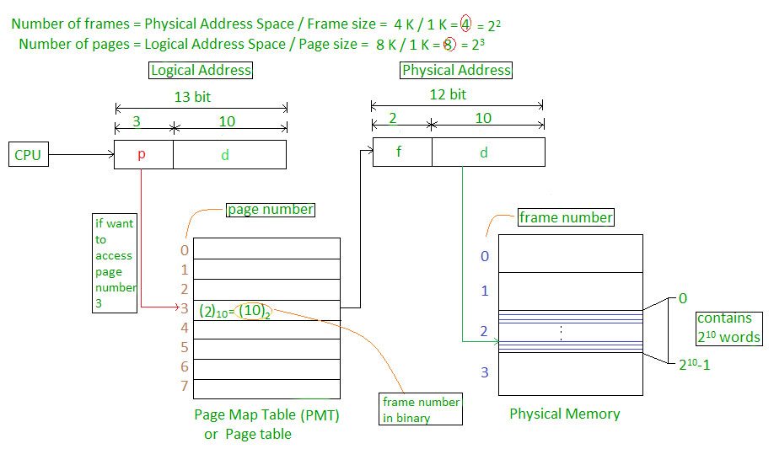

Slide 7
CPU is divided into
Page number(p): Number of bits required to represent the pages in Logical Address Space or Page number
Page offset(d): Number of bits required to represent particular word in a page or page size of Logical Address Space or word number of a page or page offset.
Physical Address is divided into
Frame number(f): Number of bits required to represent the frame of Physical Address Space or Frame number.
Frame offset(d): Number of bits required to represent particular word in a frame or frame size of Physical Address Space or word number of a frame or frame offset.

Slide 8
The hardware implementation of page table can be done by using dedicated registers.
But the usage of register for the page table is satisfactory only if page table is small.
If page table contain large number of entries then we can use TLB(translation Look-aside buffer), a special, small, fast look up hardware cache.
The TLB is associative, high speed memory.
Each entry in TLB consists of two parts: a tag and a value.
When this memory is used, then an item is compared with all tags simultaneously.
If the item is found, then corresponding value is returned.

Slide 9
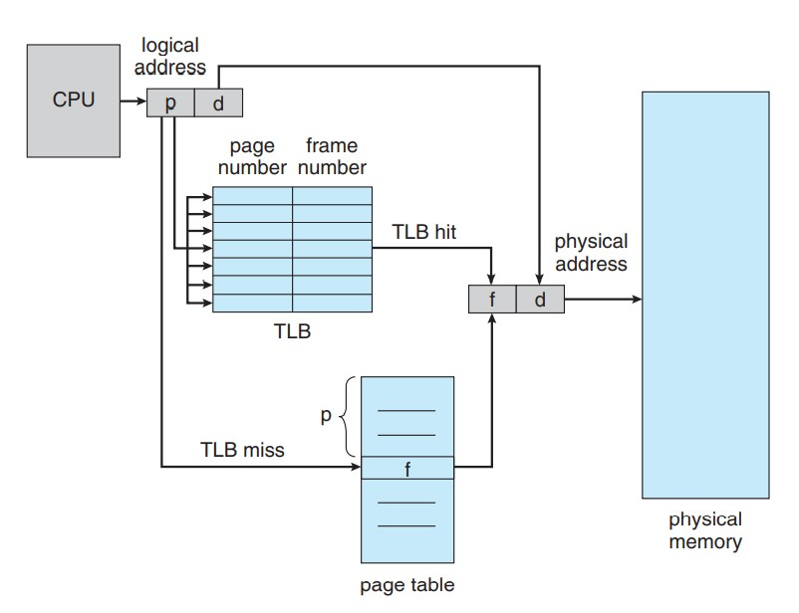
Translation Lookaside Buffer

Slide 10
A Translation look aside buffer can be defined as a memory cache which can be used to reduce the time taken to access the page table again and again.
It is a memory cache which is closer to the CPU and the time taken by CPU to access TLB is lesser than that taken to access main memory.
In other words, we can say that TLB is faster and smaller than the main memory but cheaper and bigger than the register.
TLB follows the concept of locality of reference which means that it contains only the entries of those many pages that are frequently accessed by the CPU.

Slide 11
In translation look aside buffers, there are tags and keys with the help of which, the mapping is done.
TLB hit is a condition where the desired entry is found in translation look aside buffer. If this happens then the CPU simply access the actual location in the main memory.
However, if the entry is not found in TLB (TLB miss) then CPU has to access page table in the main memory and then access the actual frame in the main memory.
Therefore, in the case of TLB hit, the effective access time will be lesser as compare to the case of TLB miss.
If the probability of TLB hit is P% (TLB hit rate) then the probability of TLB miss (TLB miss rate) will be (1-P) %.

Slide 12
Therefore, the effective access time can be defined as;
EAT = P (t + m) + (1 - p) (t + k.m + m)
Where, p → TLB hit rate, t → time taken to access TLB, m → time taken to access main memory k = 1, if the single level paging has been implemented.
By the formula, we come to know that
Effective access time will be decreased if the TLB hit rate is increased.
Effective access time will be increased in the case of multilevel paging.

Slide 13
Structure of Page Table
Page Table is a data structure used by the virtual memory system to store the mapping between logical addresses and physical addresses.
Logical addresses are generated by the CPU for the pages of the processes therefore they are generally used by the processes.
Physical addresses are the actual frame address of the memory. They are generally used by the hardware or more specifically by RAM subsystems.
The image given below considers,

Slide 14
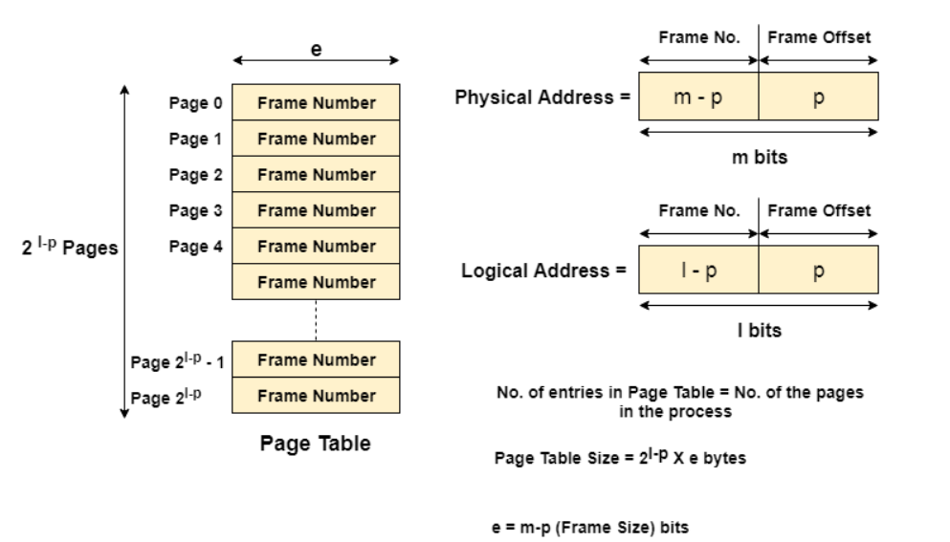
Physical Address Space = M words Logical Address Space = L words Page Size = P words Physical Address = log ₂ M = m bits Logical Address = log ₂ L = l bits page offset = log ₂ P = p bits

Slide 15
The CPU always accesses the processes through their logical addresses. However, the main memory recognizes physical address only.
In this situation, a unit named as Memory Management Unit comes into the picture. It converts the page number of the logical address to the frame number of the physical address. The offset remains same in both the addresses.
To perform this task, Memory Management unit needs a special kind of mapping which is done by page table. The page table stores all the Frame numbers corresponding to the page numbers of the page table.
In other words, the page table maps the page number to its actual location (frame number) in the memory.
In the image given below shows, how the required word of the frame is accessed with the help of offset.

Slide 16
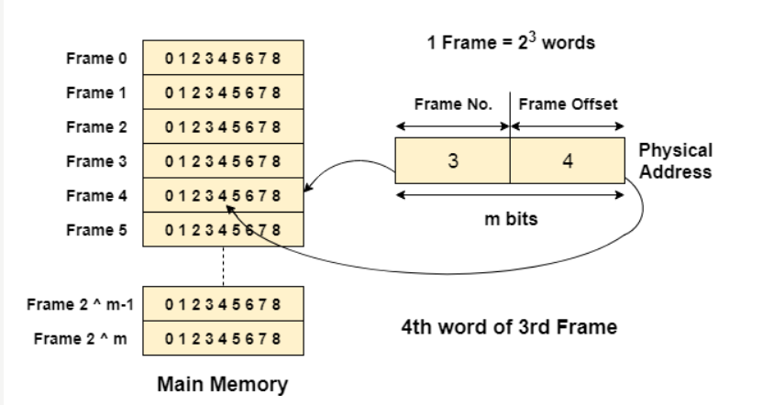

Slide 17
Q.1 A paging scheme using TLB. TLB Access Time 10 ns and main memory access time takes 50 ns. What is Effective Memory Access Time (in ns) if TLB hit ratio is 90% and there is no page fault?

Slide 18
Page Table Entries in Page Table
A Page Table is a data structure used by the operating system to keep track of the mapping between virtual addresses used by a process and the corresponding physical addresses in the system’s memory.
A Page Table Entry (PTE) is an entry in the Page Table that stores information about a particular page of memory. Each PTE contains information such as the physical address of the page in memory, whether the page is present in memory or not, whether it is writable or not, and other access permissions.
The size and format of a PTE can vary depending on the architecture of the system and the operating system used. In general, a PTE contains enough information to allow the operating system to manage memory efficiently and protect the system from malicious or accidental access to memory.

Slide 19
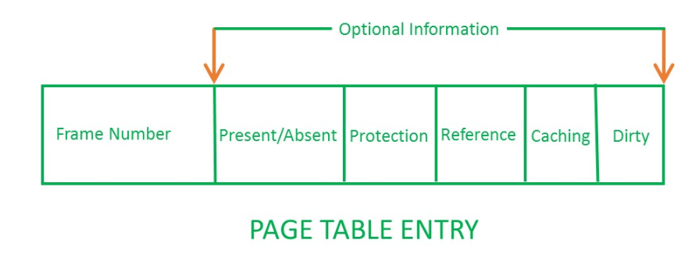
The number of Page Table Entries in a Page Table depends on the size of the virtual address space used by a process and the size of the memory pages used by the system.
For example, if the virtual address space of a process is 32 bits, and the system uses 4 KB pages, then the Page Table will have 2^20 (1 million) entries, with each entry being 4 bytes in size.

Slide 20
Information Stored in Page Table Entry
Frame Number – It gives the frame number in which the current page you are looking for is present. The number of bits required depends on the number of frames. Frame bit is also known as address translation bit.
Number of bits for frame = Size of physical memory / Frame Size
Present/Absent Bit: Present or absent bit says whether a particular page you are looking for is present or absent. In case it is not present, that is called Page Fault. It is set to 0 if the corresponding page is not in memory. Used to control page faults by the operating system to support virtual memory. Sometimes this bit is also known as a valid/invalid bit.

Slide 21
Protection Bit: The protection bit says what kind of protection you want on that page. So, these bits are for the protection of the page frame (read, write, execute, etc).
Referenced Bit: Referenced bit will say whether this page has been referred to in the last clock cycle or not. It is set to 1 by hardware when the page is accessed.
Caching Enabled/Disabled: Sometimes we need fresh data. Let us say the user is typing some information from the keyboard and your program should run according to the input given by the user. In that case, the information will come into the main memory. Therefore main memory contains the latest information which is typed by the user.

Slide 22
Modified Bit: Modified bit says whether the page has been modified or not. Modified means sometimes you might try to write something onto the page. If a page is modified, then whenever you should replace that page with some other page, then the modified information should be kept on the hard disk or it has to be written back or it has to be saved back. It is set to 1 by hardware on the write-access to a page which is used to avoid writing when swapped out. Sometimes this modified bit is also called the Dirty bit.

Slide 23
Characteristics of the Page Table
Some of the characteristics of the Page Table are as follows:
It is stored in the main memory.
Generally; the Number of entries in the page table = the Number of Pages in which the process is divided.
PTBR means page table base register and it is basically used to hold the base address for the page table of the current process.
Each process has its own independent page table.

